Slide 1
What Killed The Computer?
Team: Electronics Idiots Games
Consisting of: Jude, Will & Hao

Slide 2
Cluedo With A Computer
A grid with 9 different storage locations on the computer.
Find out between you and 3 other programs on What Killed The Computer?
2 Dice rolls per turn – Move between 2 and 12 spaces.
Correctly accuse the correct program, malware and which storage device the murder occurred wins the case. Guess one or more wrong then the player is out of the investigation, choose carefully.

Slide 3
The Cards
The 6 Malware Cards
Trojan
Worm
Virus
Bot
Spyware
Phishing
The 9 Storage Location Cards
Hard Drive Disk
Floppy Disk
Compact Disc
USB Flash Drive
Solid State Drive
Secure Digital Card
Tape
DVD disc
Cloud
The 6 Program Cards
Miss Mail
Professor Paint
Mrs. Edge
General Fox
Colonel Chrome
Dr Discord

Slide 4

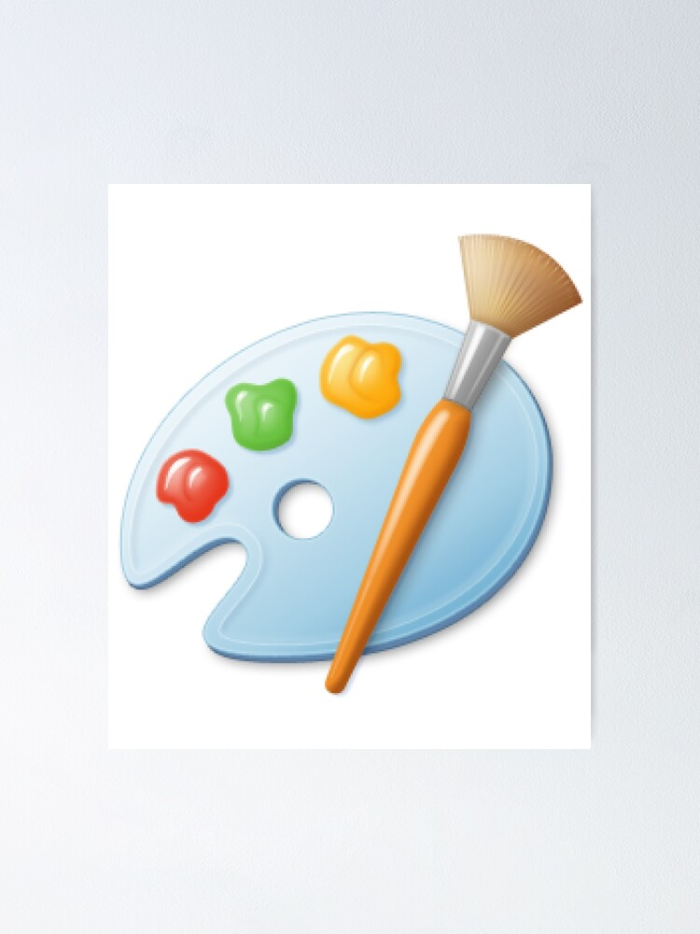




Meet The Programs
General Firefox
Miss Mail
Mrs. Edge
Professor Paint
Dr Discord
Colonel Chrome

